Slide 1
NodeJS Development
Project Setup and Automation

Slide 2
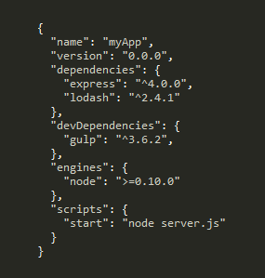
NodeJS Basics
NodeJS not pre compiled
Project defined by package.json
Node process interprets startup .js file
Based on Google’s V8 engine

Slide 3

NodeJS Packages
Managed using Node Package Manager (npm)
Application’s dependencies stored in package.json
Loaded in NodeJS applications using require

Slide 4
Writing Code
Text Editors
VIM, SublimeText, Atom
IDEs
WebStorm
Visual Studio – NodeJS Tools
Other Tools
JSLint, JSHint

Slide 5
Task Runners
Task Runners
Grunt, Gulp
Testing
Mocha, Karma
Debugging
node-inspector

